Slide 1
Case Note Training
December 2021 WIOA Training Academy
Liz Smith

Slide 2
Your Questions…..
Is there a proper title to use on case notes?
Why can't there be an option to edit the case note instead of having to get the note deleted and rewriting if a mistake is made or something left out, misspelled, etc.?

Slide 3
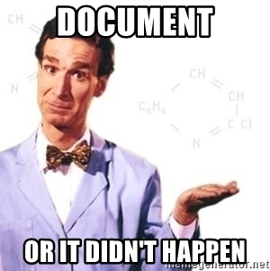
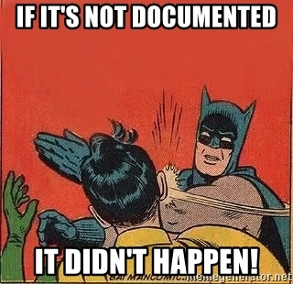
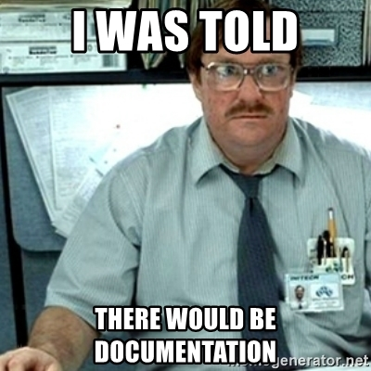
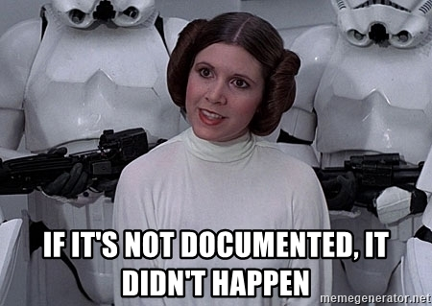
REMEMBER
IF IT IS NOT DOCUMENTED
THEN IT DID NOT HAPPEN!!!!

Slide 4
Arkansas State Requirements for Case Notes
Required to be made at enrollment, at least once a month during participation, when a service has been provided or any contact has been made, at exit and during follow-up;
Include information regarding the determination of eligibility as well as info relating to the determination of need for career, training, supportive or other services;

Slide 5
Writing A Case Note
When writing case notes, the biggest factor to consider is the AUDIENCE!
Three Standards for a good case note:
Be Clear-Audience can understand the note. It should be written in an active voice with short, direct sentences and is specific in content;
Relevant-The note is related to the case. There should be a connection between the participant’s goals and objectives to the services being rendered;
Useful-The case note should have a purpose-it should tell the story detailing how the services/resources are helping.

Slide 6
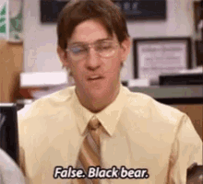
1st Gift Card Question….
How often should you add a case note?
At least once a month
Whenever something significant happens and/or at least once a month
Only when supportive services are being offered
Only when my Manager notices I have missed some

Slide 7
BRO CRIP Structure and What It Means
B-Background Statement
Participant’s situation, including the conditions and circumstances around which the interview was scheduled
R-Reason Statement
Purpose, function or intended use of the interview
O-Observation Statement
Could be good or bad and are always objective (fact) and never subjective (opinion)
C-Content Statement
Substance of the interview; a summary of the events of the interview
R-Results Statement
Outcome of the interview; Did the meeting accomplish its purpose?
I-Impressions Statement
Overall assessment of the progress the participant is making in attaining their goals
P-Plan Statement
States what will happen next focusing on the next steps

Slide 8
Case Note Dos and Don’ts
DO:
DO NOT:
Keep intended audience in mind;
Be clear and concise;
State facts, not your opinions;
Be specific;
Avoid sweeping generalizations;
Summarize confidential information rather than recording in detail;
Include any and all relevant info relayed by participant.
State personal opinions;
Record personal info in detail;
Write one sentence notes, or omit important info;
Discuss conversations had by management in case notes

Slide 9
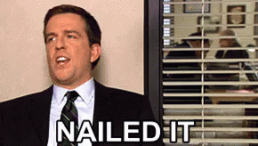
2nd Gift Card Question
What does the “P” in the acronym BRO CRIP stand for?
A. Plan Statement
B. Project Goals
C. Purple Pig
D. Purpose

Slide 10
Opinions Vs. Facts
Opinion
Fact
Participant has a drinking problem.
Participant does not write and read well.
Participant came into the office looking nasty and smelling bad so therefore he is homeless.
Participant came in with a child and did not have a ring on her wedding finger, therefore she is a single parent.
Career Advisor smelled alcohol on participant’s body and observed slurred speech and red eyes.
Career Advisor noticed the participant was struggling with the application. Career Advisor asked the participant if he needed assistance.
Career Advisor asked the participant about their living situations and discovered that the participant is homeless.
Career Advisor checked the application for barriers and discovered that the participant is a single parent.

Slide 11
Common Mistakes in Case Notes
One sentence case notes…..
Documenting without showing what WIOA or partner services have provided…..
You cannot tell the participants story in a one-sentence case note.
Jan is conducting job search (what is WIOA doing)
Jan has completed OST (next step)
Jan passed her final exams (what is the next step, what services were provided, is this a follow up on a previous case note?)
Jan will keep me informed on how her interview went (sounds like Jan is doing this on her own)
CA spoke to Jan today; She is looking for part-time employment while she is participating in OST. Jan informed CA that she has an interview coming up this week and is nervous. (she told you she was nervous yet there were no services provided)
CA spoke to Eddy today and reminded him that Friday will be his last day of work experience. Eddy will be conducting job search. (Why is he not being assisted with job search)
Denise called CA today and informed her that she was arrested Thursday night and did not get released till today. Denise was not at her worksite today. (Denise needs counseling and possibly a referral to legal aid)

Slide 12
Examples of “not so good” Case Notes

Slide 13
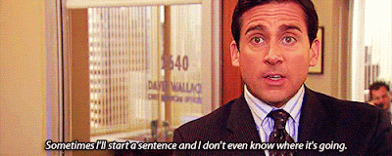
3rd Gift Card Question
What should you avoid putting in a Case Note?
Opinion instead of Fact
Detailed medical information
Conversations had by management
All of the above

Slide 14
PIRL # and Descriptor Information
Double click on image

